Slide 1

Fernwood 3 Day Sale is HERE Get excited!!
with Belinda Amis

Slide 2
Why?
Our 3-day sale will run from Saturday 29 to Monday 31 August.
This 3 Day Sale is a great way for your club to ensure you reach
(smash ☺) August targets.

Slide 3
Todays plan…
A quick half hour to inspire and motivate you all to MAXIMISE…
Every hour
Every lead
Every appointment
Every platform
Every opportunity
….right up until 8pm Monday night.

Slide 4
Is your communications plan locked and loaded?
It goes without saying that you will call as many leads as possible but a well executes SMS and EMAIL plan will ensure that you attempt to reach every woman on your data base.
Don’t forget to plan for
- SOCIALS
- REFERRALS (Yes let your members know too)
- OUTREACH

Slide 5
Hit the phones and have some fun!
One hour call blocks with a quick break are a great way to stay energised.
Work together and bounce off of each others energy!!
A little friendly competition can be fun ☺
Blue tac 30 scratchies or Caramello Koalas to a wall and grab one each time you book an appointment. Maybe an extra bonus if the appointment is for TODAY! You will need to replenish this each day of course!
Have call and appointment targets in place for every day based on your roster.
Example: If one person rostered on from 9am – 7pm just for phone calls and lead generation, anticipate 25 calls an hour so plan for approx. 250 calls in the day.

Slide 6
Hit the phones and have some fun
Call like you’ve never called before!!
Work through your CRM calls as per normal. Also pull a list of the last 3 months of enquiries and spread the word of the 3 day sale. Leave messages and get the word out there.
Reports > New leads > Select your date range and choose Person - Lead and Person Prospect - it will give all the leads created in that date range
You also have the older to get through. You can’t work through it all in one 3 day sale, however it’s a great time to start grabbing some bite size chunks to increase activity.
Don’t forget post sign up calls.

Slide 7
Hit the phones and have some fun
If you are speaking with a prospect and the answer is NO, what is your response? You could come off the call feeling deflated or you could turn this call in to another opportunity!
“That’s OK, thank you for your time. If you have any friends or family that are wanting to wanting to work towards their health and wellness goals please pass on the message that Fernwood have amazing savings this weekend!”

Slide 8
Walk in’s and on line sales are a bonus!!
Don’t PLAN for walk in’s and on line sales, view them as a welcome extra!!
Ensure you have a strong APPOINTMENT plan in place, adequate to hit target.
300 call attempts with 20% call to contact ratio will mean 60 contacts
60 contacts with 25% contact to app ratio will mean 15 appointments
15 booked appointments with 60% show will mean 9 turn up
9 appointments with 90% close will mean 8 sales
How many sales do you need daily and make sure you know your numbers as mentioned above.
If you are planning for 8 sales a day, the above could be a good guide of the activity needed. If you are planning bigger numbers, use the above as a guide.
Get started now of course! Don’t wait until Saturday ☺

Slide 9
On line joins
Keep your eye out for on line joins.
Check for email confirmation at
clubname@fernwoodfitness.com.au
Your Sales Performance Report will reflect on line joins also.
Online joins will go straight in to the CRM as a post sign up 7 day call.
You will also see leads come through the CRM as an online join and they aren’t a member yet. This usually means they got half way through the join process but did not complete it. SUPER HOT LEADS.

Slide 10
Be time efficient
Sometimes prospects are ready to go as soon as they walk in to the club…
Ask the question…
So happy you came in to discuss how this sale can help you get started on achieving your goals. Shall I get your membership organised for you now?
The answer may be a simple YES!!
Be time efficient – calls/tours/close

Slide 11
Scripting
Limited memberships available….
I have put a membership aside for you so you don’t miss out….
Many clubs I’ve spoken to have a little something extra when prospects come in to club to join. If this is the case with your club, your scripting can reflect this so that you are maximising on line join but also promoting your extra value adds in club.
Role play Role play Role play

Slide 12
Scripting
VOICE TO TEXT Fernwood 3 Day Sale. Call (club name) NOW
VOICEMAIL
Hi (Their name),
It’s (Your name) calling from Fernwood (insert club)
This is a quick call to share the exciting news that our Fernwood 3-day sale is here!!
If you’ve been thinking about improving your health and wellness then there is no better time to get in touch. Head to our website and join on line or pop in to club for EVEN MORE SAVINGS! We can’t wait to hear from you. Have a great day. Be quick as this offer is strictly limited.

Slide 13
Scripting
Hi is that (Their name)?
Hi its (Your name) calling from Fernwood (insert club), how are you?
I know that at some stage you have enquired about our club so I wanted to share the exciting news that our Fernwood
3 DAY SALE IS HERE!! You can get started with Zero Joining fee and lots of other savings.
Do you mind if I ask if you are doing any kind of EXERCISE at the moment? (Listen and respond)
If you were to get started with us, what kind of results are you wanting to ACHIEVE? (Listen and respond)
What I’d love to do is invite you into the club to learn more about how this fantastic 3 day sale can help you get started & working towards your goals.
Does today or tomorrow suit your best to pop in and learn more?
I’ll put a membership aside for you now.

Slide 14
Strong confirmations
SMS and call
Remind them to bring their friends!
Have they completed digital GTKY
Don’t forget to call your no shows immediately

Slide 15

Socials
There is no better place to spread the word than all over your socials!!
Don’t be worried about sharing the sale offer to members. Just make sure you attach a referral offer to it so the members feel there is something for them;
“Share the Ferny love and score yourself a workout buddy. Your friends will love you and it’s great for you too because for every friend you refer to join you will receive 1 month free membership!
Tag your new favourite gym buddy below.”
This message can be used in socials, scripts for your receptionists, group fitness instructors and promoted around your club.

Slide 16
The right attitude
Go hard or go home!!
Create a great vibe where your team WANT to be in club striving towards target. Do you want to be top sales person? Top club? Beat your PB?
Check in with each other hourly to ensure the mood is still high and everyone is on track!! Communicate with other clubs. Motivate each other.
How can you inspire the team to stay on board until the job is done?!

Slide 17
Team Communication (Tip from Angela, St Kilda)
Clarity of information to the WHOLE team.
COMMUNICATE clear targets and expectations for everyone.
Break them down.
Plan HOW targets will be achieved.

Slide 18
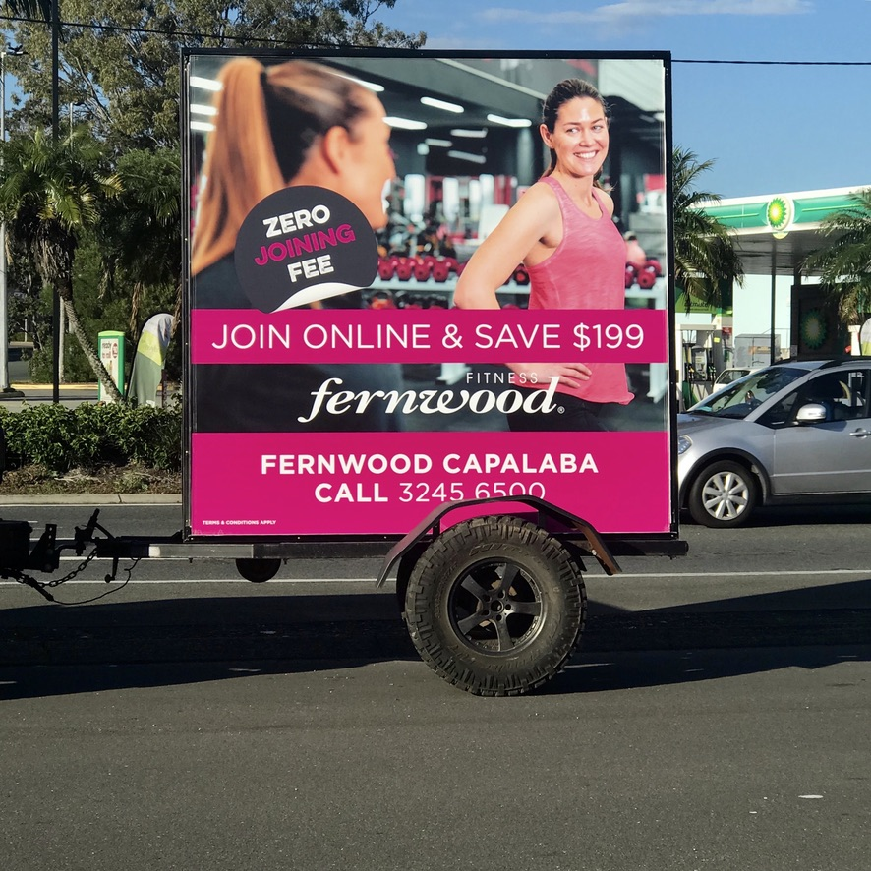
Look and feel (Tip from Chloe, Capalaba)
A frames
Road signs
Balloons
Team members exercising
Anything to grab attention…..
Show case these pic’s on your socials
Billboard such as the one pictured! Move it around in line with
Parking limits.
Don’t forget to decorate the inside of your club too.
Yes you want your members to know that their friends can grab a
great offer and there is something in it for them also!!

Slide 19
Urgency (Tip from Chloe, Capalaba)
With every call….
With every action…
Spend each hour wisely!

Slide 20
Referrals (Tip from Andrew, Maroochydore and Robina)
What is your clubs standard referral program? Use it ☺
Do you have a special referral offer in place for August? Use it ☺
Coffee card, VISA gift card, 5 pack PT, 1 month FREE…options are endless.
Don’t forget to qualify all referrals
Add the urgency of the 3 day sale
“Get your friends started by this weekend and ….”
Are referrals worth the effort? YES YES YES

Slide 21
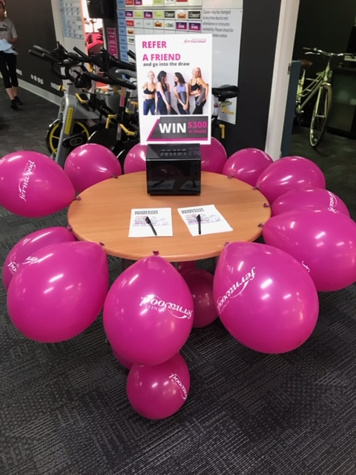
Referrals
Referrals are a WIN WIN WIN
Something in it for the new member
Something in it for the referring member
Something in it for the club
Referrals are the BEST leads you can
receive.

Slide 22
FREE class pass (Tip from Andrew, Maroochydore and Robina)
A FREE class pass is a great way to offer an EXPERIENCE to your prospects.
Bring them in to experience your clubs WOW factor.
Maybe each pass could say “call the club to reserve your place”
This way each prospects is in the sales calendar so you can catch them before/after their workout. After a proper needs analysis I'm sure these woman will be excited to jump on the 3 day sale offer.
(or whatever your current offering is)

Slide 23
Referrals (Tip from Andrew, Maroochydore and Robina)
So how do you spread the word..
Current members
Outreach
Team members giving out passes to their circles
Instructors giving them out at the end of group fit classes
Socials
Get instructors on your social pages.
Real women, real stories.
”Come and join me for Body Balance on Thursday at 6.30pm”

Slide 24
Know your why (Lee, Ballarat)
The fish ROCKS from the head.
Bring your confidence, energy and enthusiasm!
Know your WHY! Share the vision! Growth & happy members.
Invest time in to training the basics and this will reward you daily, weekly, monthly. Come a 3 day sale like this one, you are ready to go.
What is your training plan for September?

Slide 25
Brush up on your listening (Tip from Keirsten, Mornington)
Build rapport, listen to their needs and get her started on the membership you think she NEEDS, not one you assume she can afford.
If you do this you will find UPGRADE opportunities everywhere.
This applies during a sale too ☺
If it’s a no. Its ok, could just be a not now or a not yet…maybe if the time is not right for them they could suggest it to their friends
Keep calling your hot leads until you have an opportunity to speak.
You are not annoying them, they enquired

Slide 26
Work together (Guneet, Clayton and Narre Warren)
Reception and sales are the ONE TEAM – work together ☺
Have the extra resources rostered.
Think… calls, outreach, tours, back end of sale, emails and SMS, servicing of current members.
Backtrack your targets and work out who needs to be where and for how long.
Roaster well a cross the entire sale and make sure rosters are correct in Exerp.
Don’t forget that all of this activity will result in walk in’s and on line joins so factor this is also.

Slide 27
Consistent language (Guneet, Clayton and Narre Warren)
Consistent language – decide on it beforehand and ROLE PLAY
Example. Are you saying..
Sale ends Monday
OR
We have limited memberships available so let’s get you in as soon as possible so you don’t miss out. I’ll put a membership aside for you right now.

Slide 28
It starts and finishes with lead gen (Belinda, Castle Hill)
Spend your month building your leads data base.
If you do this well, any kind of SALE is icing on the cake.
If you don’t build your leads data base, any kind of SALE wont save the day.
Next Tuesday is Sep 1st – what lead gen activities will you focus on?

Slide 29
Team rewards (Tip from Donna, Tuggeranong)
Staff incentives/rewards – have some fun!!
You know your team will go the extra mile anyway but how about having a bit of fun with targets and accountability.
How will your team celebrate hitting target? Coffee tab, drinks tab on Friday night? Go home early one day next week?
Don’t restrict the fun to just the team new member target.
Who can generate the most leads?
Make the most phone calls?
Book the most appointments?
Close the most sales?
Do the most upgrades?

Slide 30
Good luck everyone ☺
Reminders: If you have any team members that missed out today, this webinar will be on Velpic by tonight and the notes will be placed on the intranet.
Join me same time next week as we go
Back to basics – Sales Management

